Slide 1
BMD ENG 301Quantitative Systems Physiology (Nervous System)
Introduction to Sensory Systems
Professor Malcolm A. MacIver

Slide 2
Sensory reception
What is the purpose of sensory reception?
To inform us about the environment in which we operate (external & internal)
To convert information into a form that the nervous system can interpret
Bioelectric signals

Slide 3
Overview of Sensory Systems
Exteroceptive
Sensory input linked to a network which represents some aspect of the external world
Interoceptive
Sensory input linked to a network that is responsible for representing the physiological condition of the body
Proprioceptive
Sensory input linked to a network that is responsible for representing the position of parts of the body and the strength of effort employed in movement

Slide 4
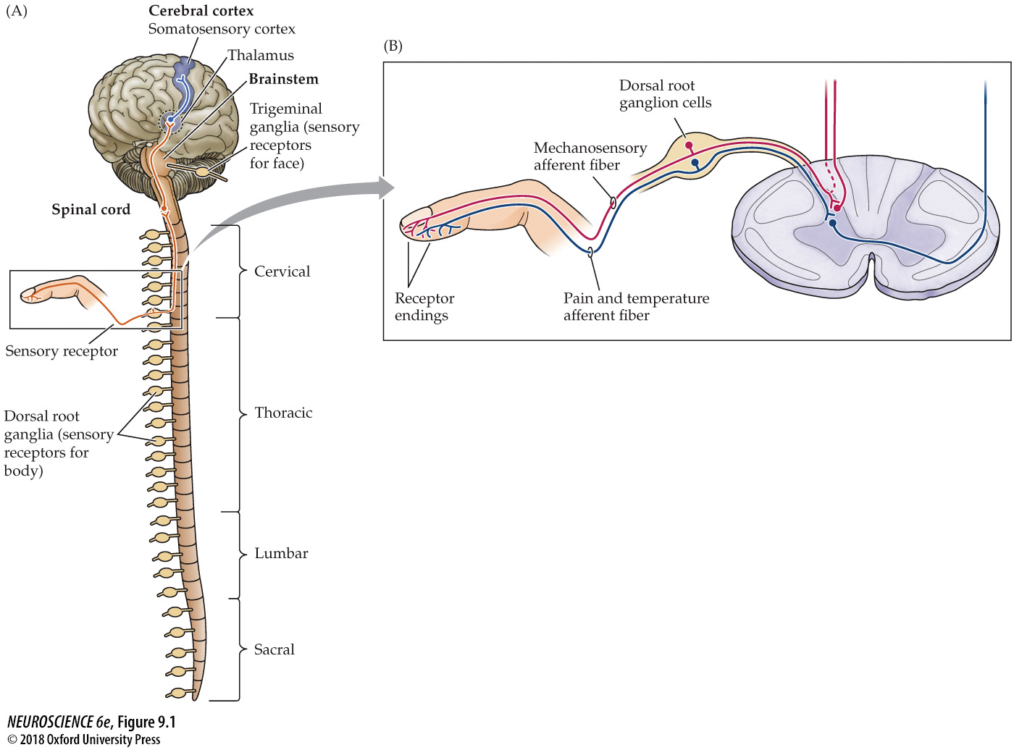
Sensory receptors depolarize the nerve membrane in response to a specific stimulus
Tactile receptors – mechanical disturbance of the skin
Pain – tissue injury
Temperature – hot or cold

Slide 5
An axon is an axon is an axon
It is “labeled” for modality in the sense of to where it connects in the brain
Some pathways register touch, others pain, others visual percepts, etc.

Slide 6
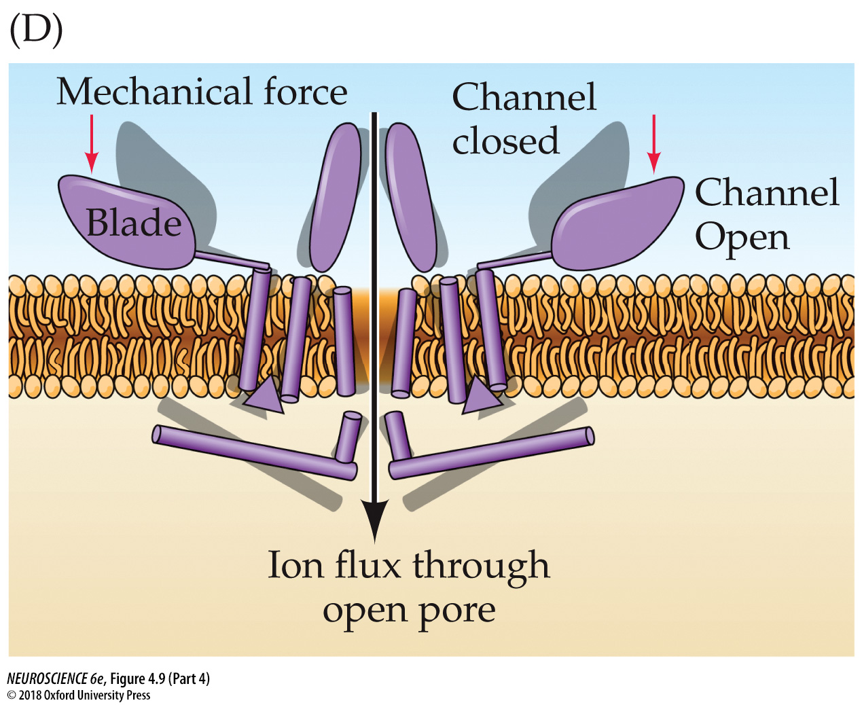

Slide 7
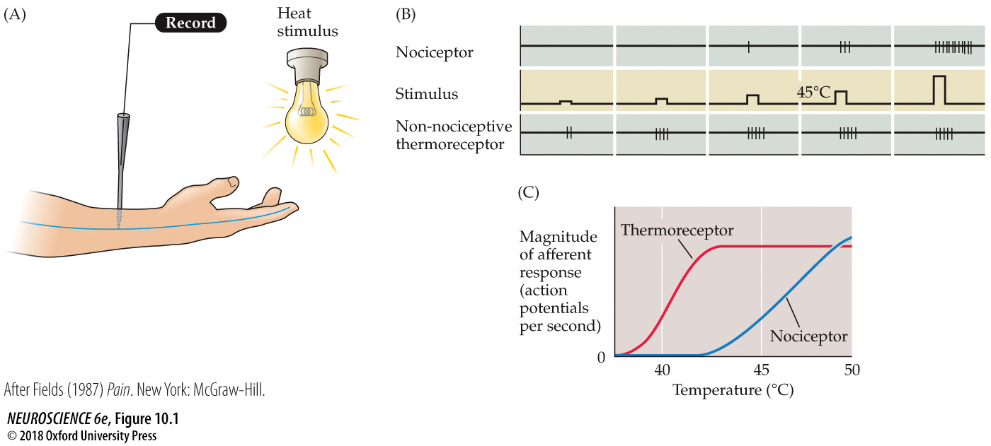
Firing of the nociceptor signals temperatures that can cause tissue damage

Slide 8
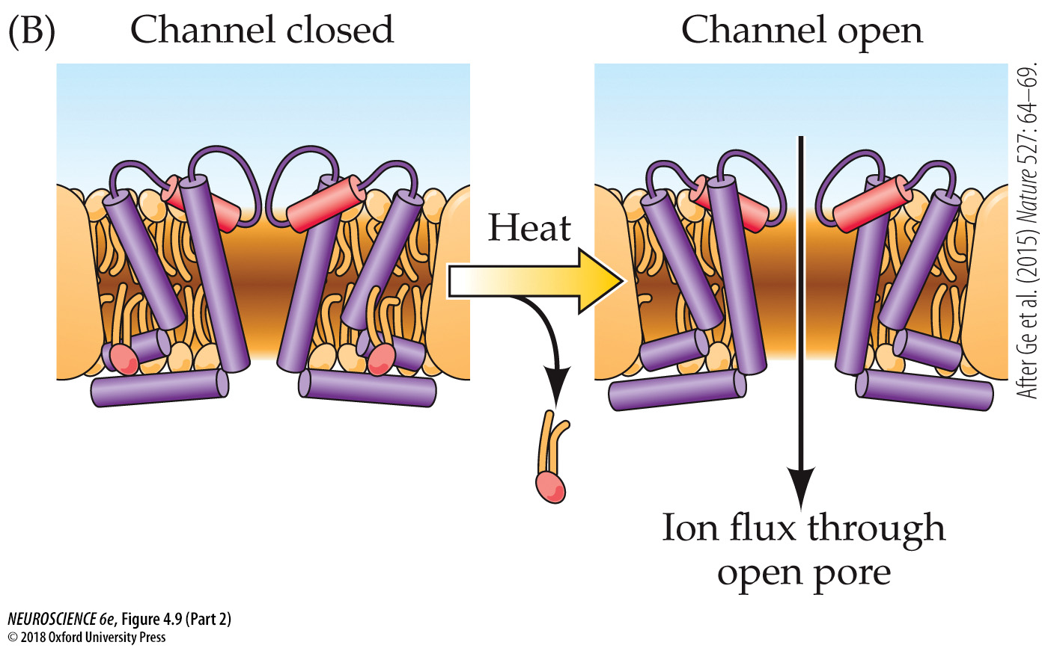

Slide 9
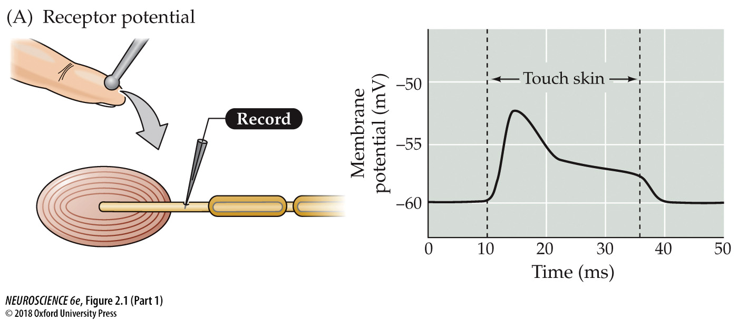
When sensory reception is far from the CNS and action potential propagation is required to register a signal there, sensory reception must result in membrane depolarization

Slide 11
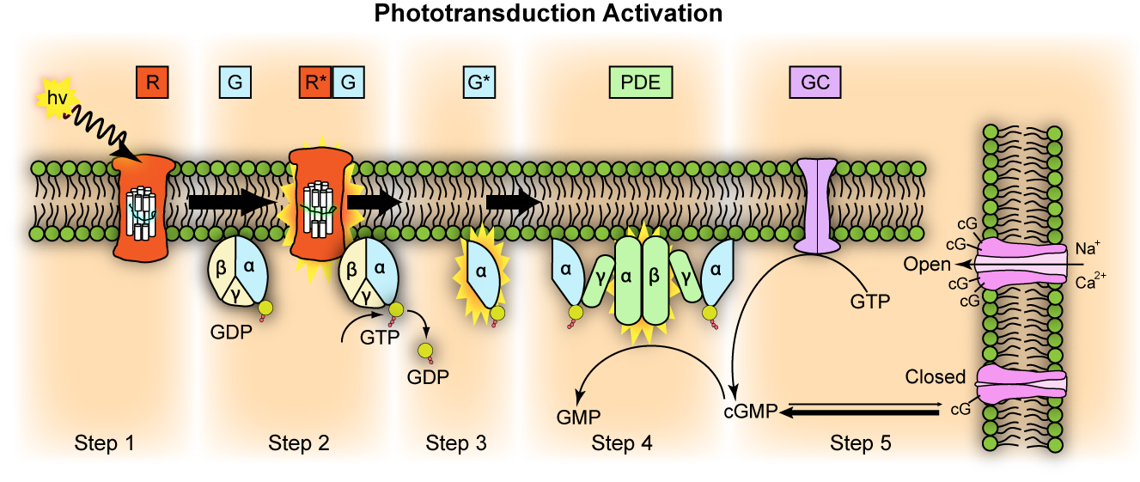
Activation Cascade
R: Rhodopsin
R*: Activated Rhodopsin (Retinal in all trans)
G: Transducin
G*: Activated alpha subunit of Transducin
PDE: cGMP Phosphodiesterase
Adaptation
GC: Guanylyl Cyclase

Slide 12
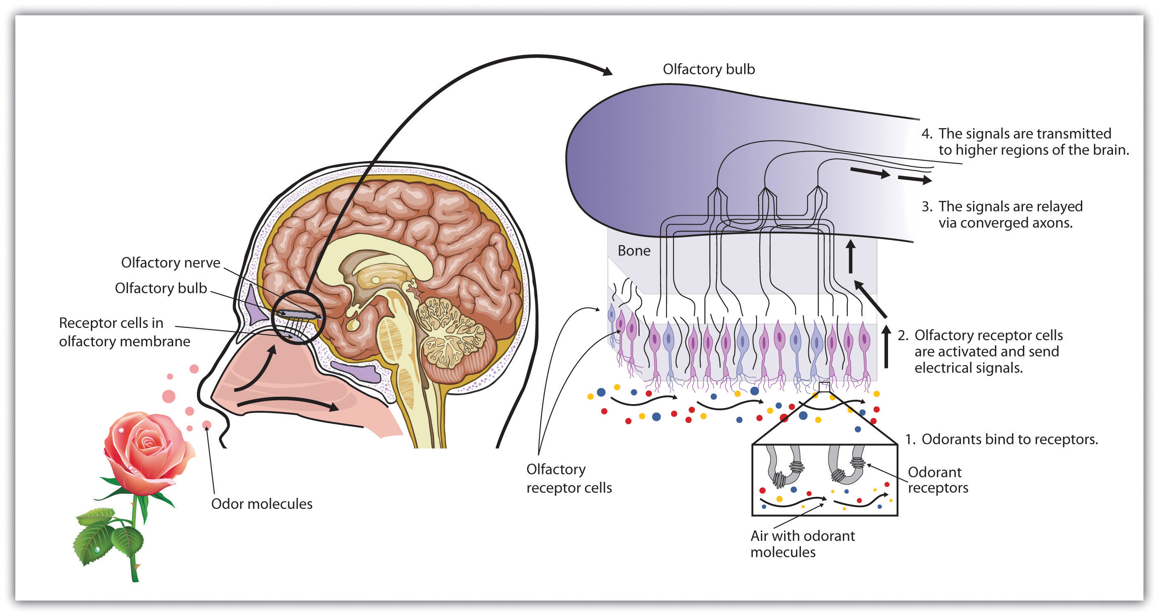

Slide 13
Overview of Sensory Systems
Exteroceptive
Sensory input linked to a network which represents some aspect of the external world
Interoceptive
Sensory input linked to a network that is responsible for representing the physiological condition of the body
Proprioceptive
Sensory input linked to a network that is responsible for representing the position of parts of the body and the strength of effort employed in movement

Slide 14
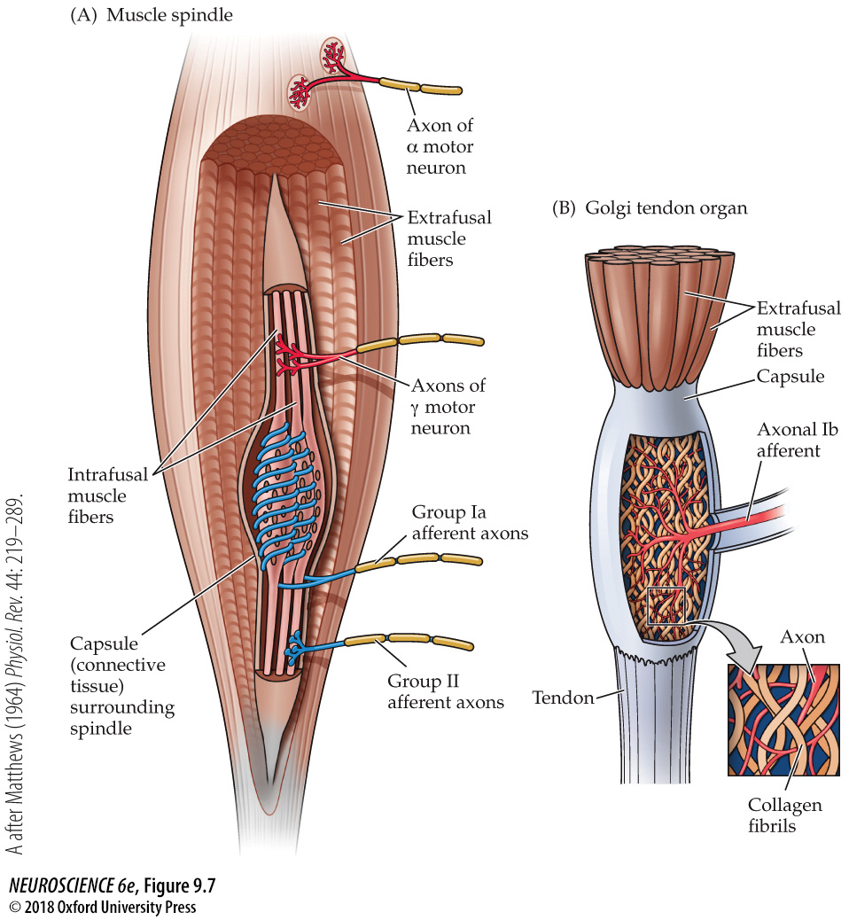
Muscle spindle
Changes in muscle contraction – steady change and rate of change
Golgi tendon organ
Change in muscle tension (force)

Slide 15
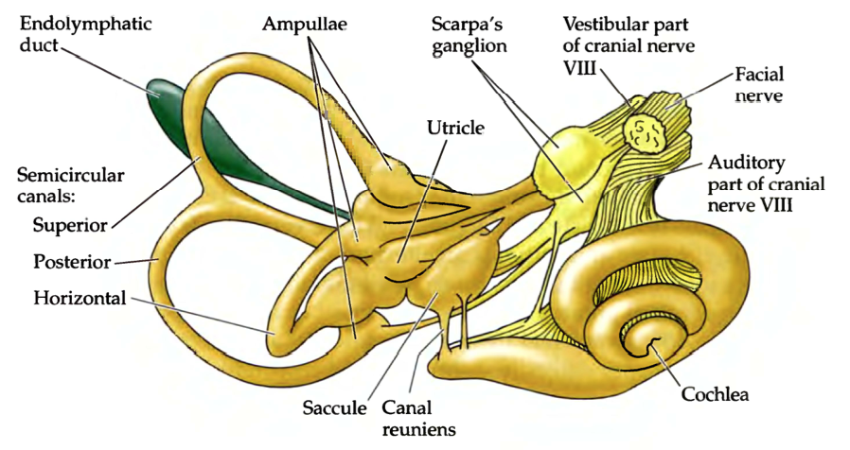
Inner Ear
Vestibular reception
Auditory Reception

Slide 16
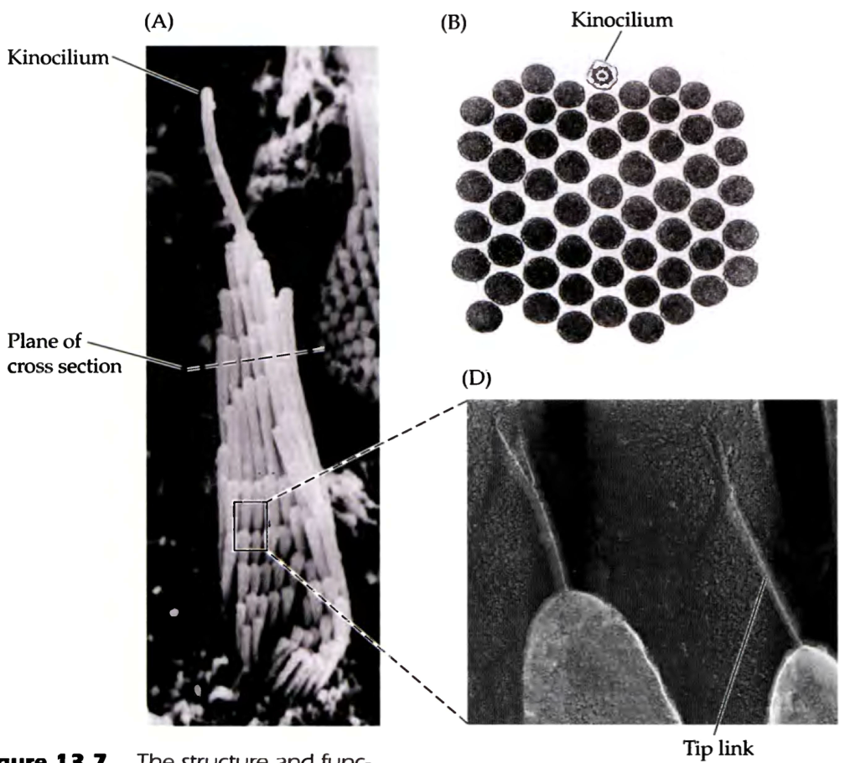
Hair Cells
30 – a few hundred stereocilia
1 larger kinocilium
Connected via tip links

Slide 17
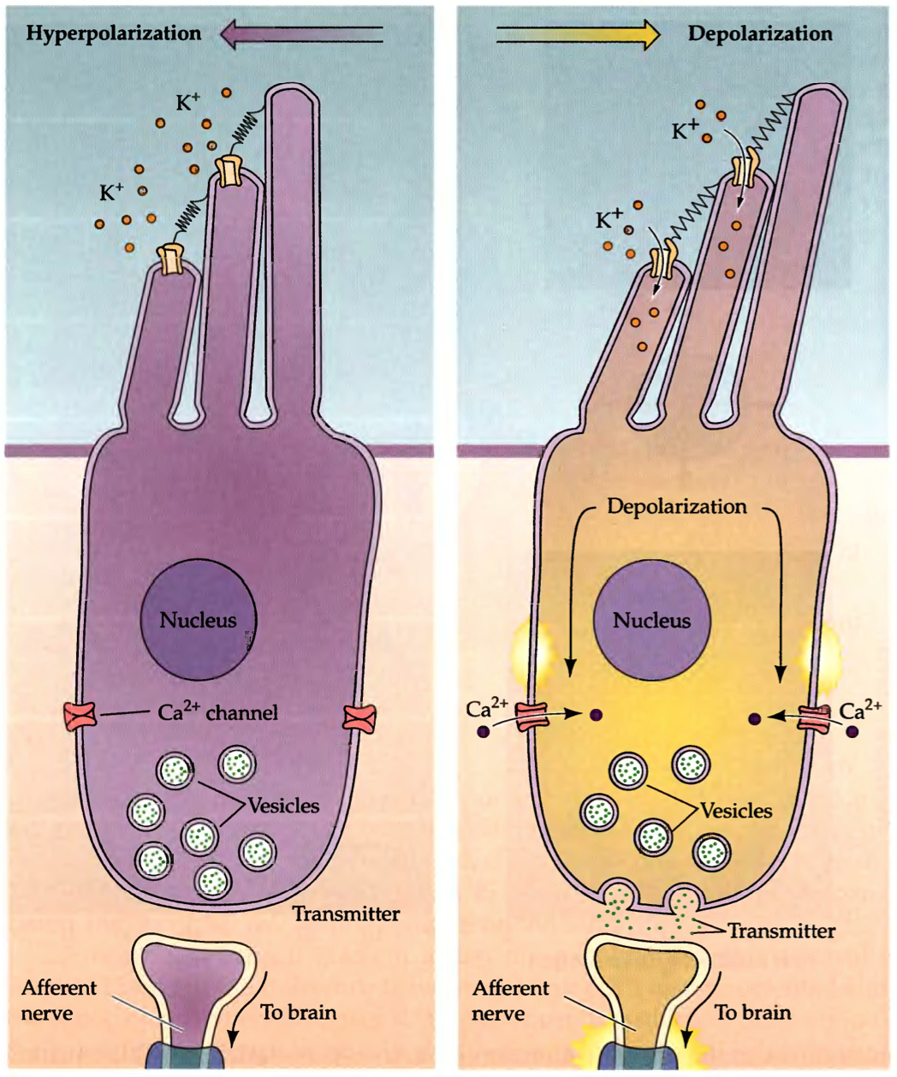
Endolymph
Unusually high [K⁺]
E_{K} is depolarizing from V_{R}

Slide 18
Coding in Sensory Systems
Stimulus intensity
Signal strength increases with stimulus strength
Stimulus modality
Labeled lines
Stimulus position
Topographic organization
Stimulus time-course
Modulation of signal over time reflects modulation of stimulus over time

Slide 19
Breaking the neural code
Neural messages are encoded as the rate of action potentials discharged (Adrian)
Mountcastle et al. (1968) sensory nerve
Discharge
rate
Stimulus intensity

Slide 20
Do not clutter the brain with what it does not need to know
Eliminate noise
Eliminate redundancy
Concentrate on what has changed
Encode what is useful

